Slide 1



E-Waste Generation Classification
Presented By: Aniket Arjun Redekar
BE. CSE 2nd Year

Slide 2

Learning Objectives
To understand how image classification works using deep learning models.
To apply transfer learning using a state-of-the-art pre-trained CNN (EfficientNetV2B0).
To learn how to prepare and process image data using augmentation techniques.
To implement model evaluation methods like accuracy, loss tracking, and confusion matrices.
To gain hands-on experience in real-time model deployment using Gradio.
To develop presentation and documentation skills for AI/ML projects.
AI-powered e-waste classification for efficient recycling.
Source :
www.freepik.com/

Slide 3
Tools and Technology used
Python – Core programming language used for development.
TensorFlow / Keras – For building and training deep learning models.
Google Colab – Cloud-based Jupyter notebook environment.
Numpy / Pandas – Data handling and preprocessing.
Matplotlib/seaborn - Visualizing dataset insights and training curves.
Scikit-learn – For confusion matrix and performance metrics.
Gradio – To build and launch a user-friendly web interface for the model.
Each tool played a unique role in enabling this end-to-end ML pipeline.

Slide 4






Methodology
Dataset Preparation
Data Augmentation
Model Selection
(EfficientNetV2B0)
Model Training
Gradio Interface Deployment
Evaluation & Metrics

Slide 5
Problem Statement:
E-waste (electronic waste) is rapidly becoming a serious environment and health issue around the world. Proper sorting and categorization of e-waste is essential for efficient recycling and disposal, but manual classification is error-prone and labor-intensive.
Description:
This project aims to build an automated e-waste classification system using artificial intelligence and machine learning. By training a deep learning model on images of different types of e-waste, we can identify and categorize them accurately.

Slide 6
Goal:
The primary goal of this project is to build a highly accurate image classification model using deep learning to automatically recognize different types of e-waste.
Specific sub-goals:
Classify images into 10+ predefined e-waste categories.
Minimize model error and improve prediction confidence.
Deploy the model through an easy-to-use web interface.

Slide 7
Solution:
Used EfficientNetV2B0, a state-of-the-art CNN pre-trained on imageNet.
Fine-tuned the model on custom e-waste image dataset.
Applied image augmentation to generalize better on new inputs.
Achieved ~96% test accuracy on unseen data.
Built and deployed a real-time prediction interface using Gradio.
Saved the model in .keras format for easy reuse or integration

Slide 8
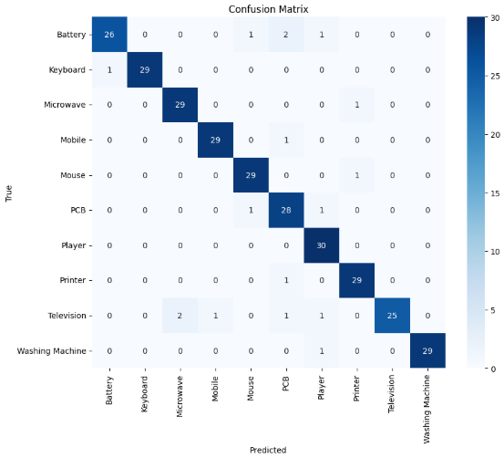
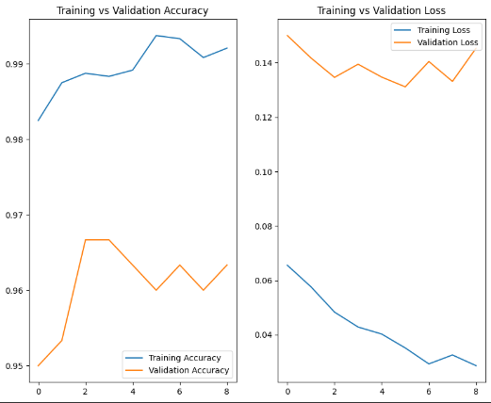
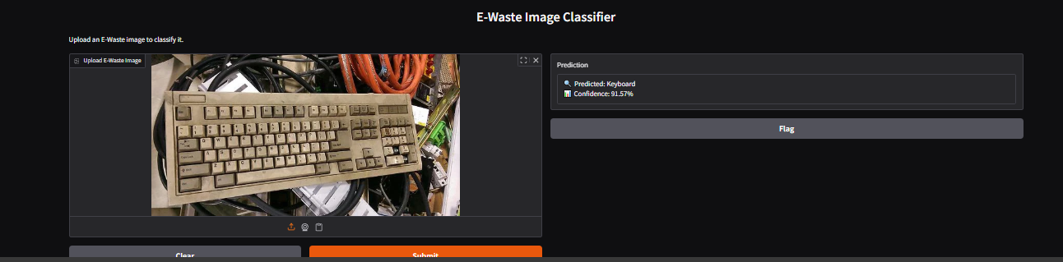
Screenshot of Output:
Confusion
matrix heatmap:
Accuracy/loss
graph:
Gradio interface:

Slide 9
Future Scope & Impact:
Mobile app integration for personal e-waste classification.
Real-time edge deployment using Raspberry Pi or IOT devices.
Extension to more categories and real-world mixed environments.
Integration with city-level recycling systems for smart waste sorting.
Impact:
Environment Conservation.
Cost & Labor Efficiency.
Scalable Solution for Urban Waste Management.
Promotes Sustainable Tech use.

Slide 10
Conclusion:
This project demonstrate a complete ML workflow – from problem definition to deployment – using real-world data. The final model not only provides high prediction accuracy (~96%) but also includes:
A clean, real-time interface.
Tools that make it ready for practical use in e-waste sorting systems.
Key Takeaways:
Learned how to structure and complete an AI project end-to-end.
Understand the importance of deployment and user experience.
Gained hands-on experience in deep learning, transfer learning, gradio.

Slide 11
THANK YOU…

